Slide 1







Express.js Fundamentals
Course Overview,
Trainers, Evaluation
Express.js Development
SoftUni Team
Technical Trainers
Software University
http://softuni.bg

Slide 2


Table of Contents
Course Objectives
Course Program
Trainers Team
Course Schedule
Exams and Evaluation
Learning Resources

Slide 3
Have a Question?
sli.do #express-js

Slide 4







SoftUni Diamond Partners

Slide 5




JavaScript Web
Module Overview

Slide 6
JS Web Module Goals
4 months intensive JavaScript framework training
4 times weekly, lots of live coding, homework and projects
Part I – Express.js
Node.js, MongoDB, Express.js Web Server
Part II – React.js
React basics, JSX, components, Redux connection
Part III – Angular 2
Angular basics, TypeScript, Service and Dependency Injection

Slide 7
JS Web Module at SoftUni – Timeline
25-Sep-2017
24-Oct-2017
21-Nov-2017
16-Dec-2016
2-Jan-2018
Express.js
Lessons + exercises + exam
4 weeks * 4 times / week
8 credits
Start: 25-Sep-2017
Final exam: 22-Oct-2017
React.js
Lessons + exercises + exam
4 weeks * 4 times / week
8 credits
Start: 24-Oct-2017
Final exam: 19-Nov-2017
Angular 2
Lessons + exercises + exam
4 weeks * 4 times / week
8 credits
Start: 21-Nov-2017
Final exam: 15-Dec-2017
Winter Break
2 weeks
Re-Take Exams
3 exams
2 ÷ 10 Jan 2018

Slide 8



Express.js Fundamentals
Express.js Fundamentals
Course Objectives & Program

Slide 9



Course Objectives
Learn:
Web server fundamentals
HTTP fundamentals
Node.js & Express.js
Non-relational databases (MongoDB)
MVC Architecture
End-to-end JavaScript applications

Slide 10
Warning: Not for Absolute Beginners
The "Node.js" course is NOT for absolute beginners
Take the HTML & JavaScript courses at SoftUni first: https://softuni.bg/trainings/1271/web-fundamentals-html-css-november-2015 https://softuni.bg/trainings/1295/javascript-basics-january-2016
This course is OK for beginners, but requires previous coding skills
Requirements
HTML & JS (ES 2016) coding skills – entry level
Computer English – entry level

Slide 11
Course Topics
Course Introduction
Introduction to Web Servers and HTTP
Introduction to Node.js
Node.js development tools
Node.js commonly used modules
MongoDB & Mongoose
Express.js & View Engines
Architecture & Code Styling

Slide 12
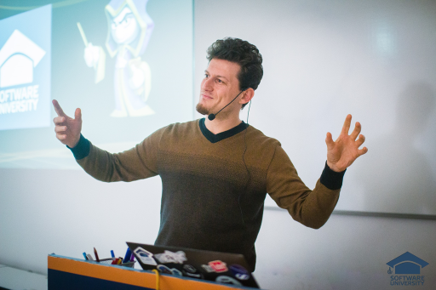
The Trainers Team

Slide 13

Trainers Team
Viktor Kostadinov
Training Manager @ Software University
JavaScript Training Lead
Programmed as a hobby since high school
Developed a resource-sharing website during his university years
Interests include astronomy and game development

Slide 14

Trainers Team (2)
Kiril Kirilov
Techinal Trainer @ Software University
Involved with programming since 11th grade
Recently interested in web development with JavaScript
Currently studying Math & Informatics at the University of Sofia

Slide 15

Trainers Team (3)
Hristian Hristov
Assistant Trainer @ Software University
Passionate about JavaScript
Freelance Web Developer
Finished Train the Trainers with top results

Slide 16
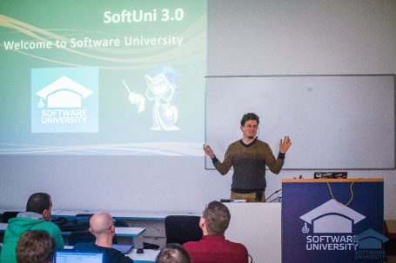


Express.js Fundamentals
Course Details and Schedule

Slide 17
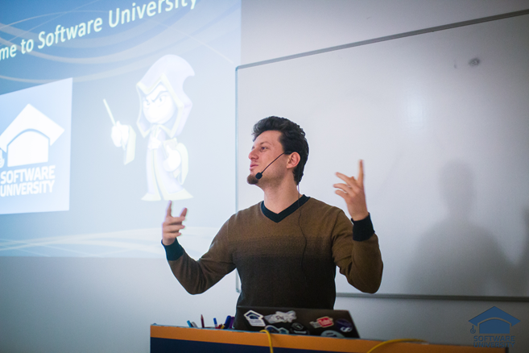
Training Duration and Schedule
Lessons: ~ 20 hours (onsite + YouTube videos)
Practical exercises (in class): ~ 40 hours
Homework: ~ 50 hours
Practical exam: 6 hours
Timeframe: Sep – Oct 2017
Final Exam: 22 Oct 2017

Slide 18


Why English?
Why the slides are in English?
English is the native language of the software engineers
Specific terminology should be in English
Translations are inaccurate and funny
Just learn English!
No excuses

Slide 19


Your RFID Chip
Students can either
Take RFID chip from SoftUni
Or use their own chip / card (125 KHz)
Register your chip number in your SoftUni profile: https://softuni.bg/users/profile/show
Check-in at the reception every time when you come in SoftUni
See your last visits in your profile: https://softuni.bg/users/profile/show

Slide 20


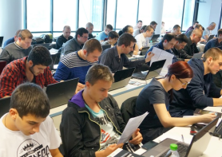
Express.js Fundamentals
Evaluation Criteria

Slide 21



Scoring System for the Course
Practical exam – 90%
Exercise submissions – 10%
Presence in class – bonus up to 5%
Forum activity – bonus up to 5%

Slide 22


Homework Assignments
Your homework is mainly work in class!
Lesson days → live workshop
Exercise days → only exercises
How to submit your homework?
Uploaded in the course Web site
Homework assignments are due in 1 week
After submission, evaluate others' work

Slide 23










Resources
What We Need Additionally?

Slide 24



Course Web Site, Forum and FB Group
Official web site:
Official discussion forum:
Official Facebook group:
softuni.bg/courses/express-js-fundamentals
softuni.bg/forum/categories/107/js-web
fb.com/groups/1928327167440858/

Slide 25

The Software Technologies Slides and Videos
All lecture slides, videos, homework assignments, projects and other resources are open content, available for free
Visit the course web site to access the course resources

Slide 26
Recommended Software
Software needed for this course:
Node.js (Current Version) - https://nodejs.org/en/download/
MongoDB - https://www.mongodb.com/download-center
Visual Studio Code – https://www.visualstudio.com
or
WebStorm – https://jetbrains.com/webstorm/

Slide 27
Course Overview
https://softuni.bg/courses/

Slide 28
License
This course (slides, examples, demos, videos, homework, etc.) is licensed under the "Creative Commons Attribution-NonCommercial-ShareAlike 4.0 International" license
Attribution: this work may contain portions from
"End-to-end JavaScript Applications" course by Telerik Academy under CC-BY-NC-SA license

Slide 29





Trainings @ Software University (SoftUni)
Software University – High-Quality Education, Profession and Job for Software Developers
softuni.bg
Software University Foundation
http://softuni.foundation/
Software University @ Facebook
facebook.com/SoftwareUniversity
Software University Forums
forum.softuni.bg

